Slide 1
Manage and monitor your Fabric tenant using the Admin monitoring workspace
Iqbal Khan
Senior Data Analyst @ Microsoft
iqbalkhan@microsoft.com

Slide 3
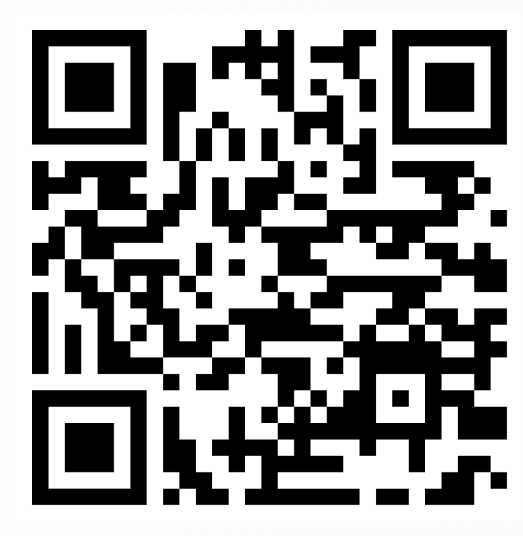
Presenter Intro
Iqbal Khan
Admin Monitoring – Reporting Lead
Joined Microsoft in 2021 as a Power BI architect
Moved to Fabric engineering in 2023
Previously spent time at Deloitte, EY, and Calendly in various engineering roles
Based in NYC with my wife Kellie and cat Jax
Fun fact: Had 5+ stroopwafels this week

Slide 4
Agenda
1
Intro / Why monitoring?
2
Admin monitoring deep-dive
3
Live demos, upcoming content, and overall roadmap
4
Q/A

Slide 5
Why monitoring?
Best practice and policy enforcement
Audit and compliance
Efficiency and reusability
Cost optimization

Slide 6
Why monitoring?
More specifically, Fabric monitoring can answer questions like:
Which workspaces have the highest number of artifacts?
What activities are guest/external users conducting in my tenant?
Do I have items shared with the entire organization through links?
An item I frequently use is missing, was it deleted? Who was it deleted by?
Which are my most widely shared items through individual users or security groups?

Slide 7
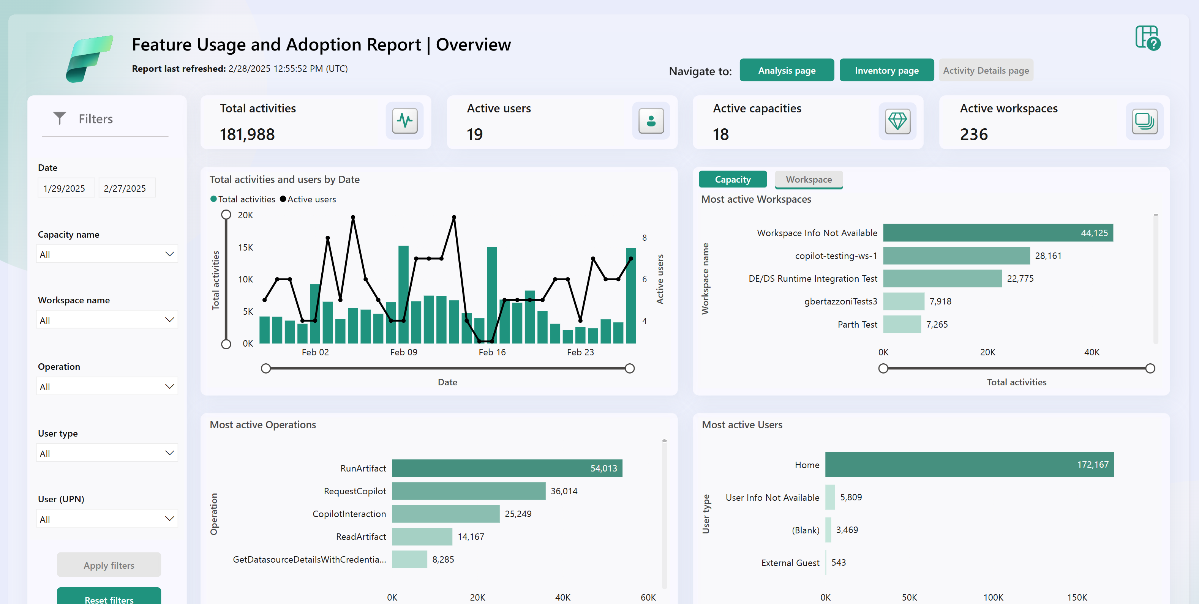
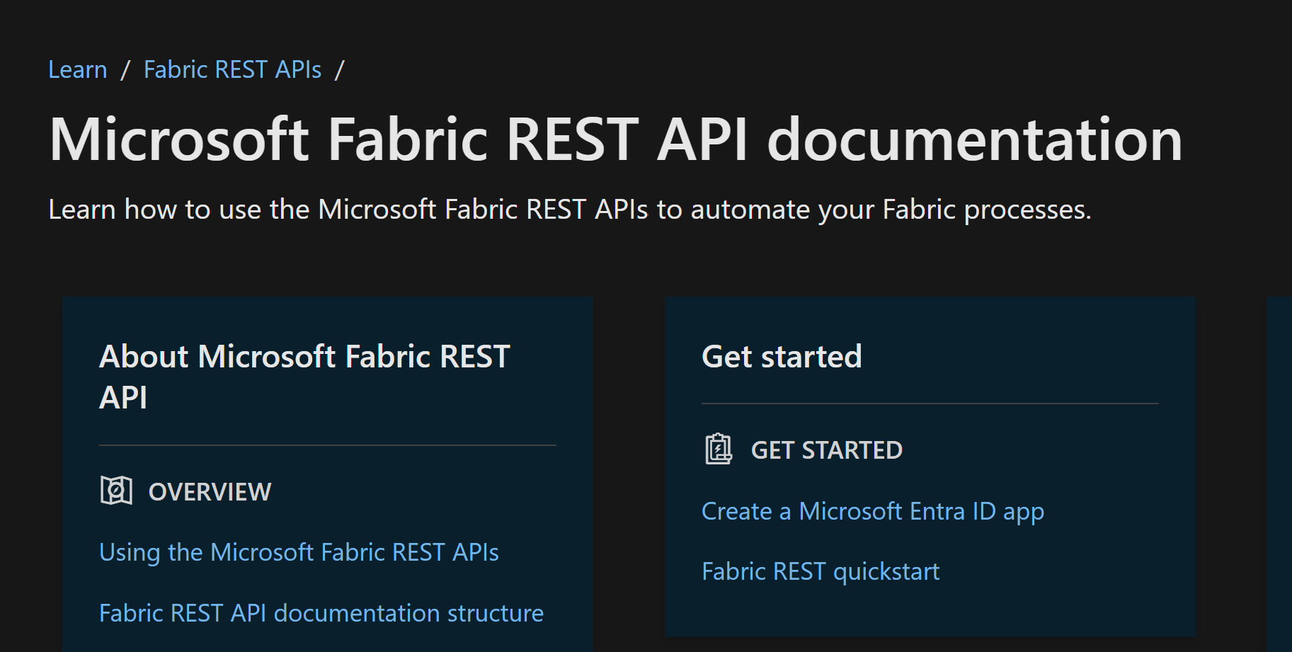
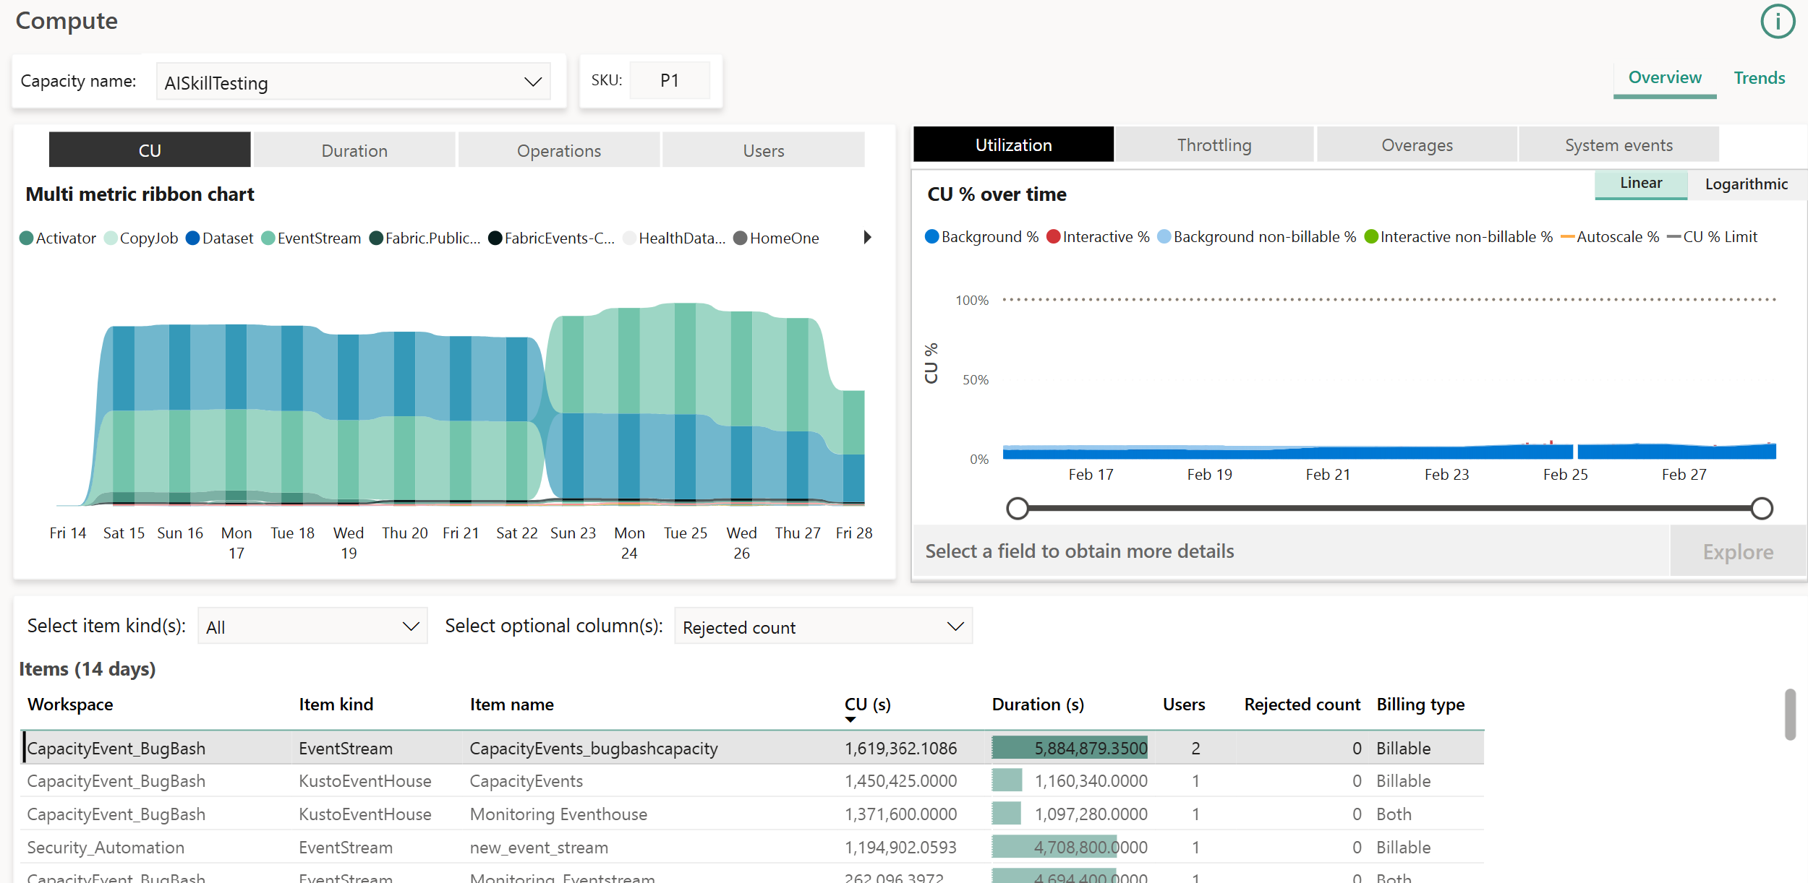
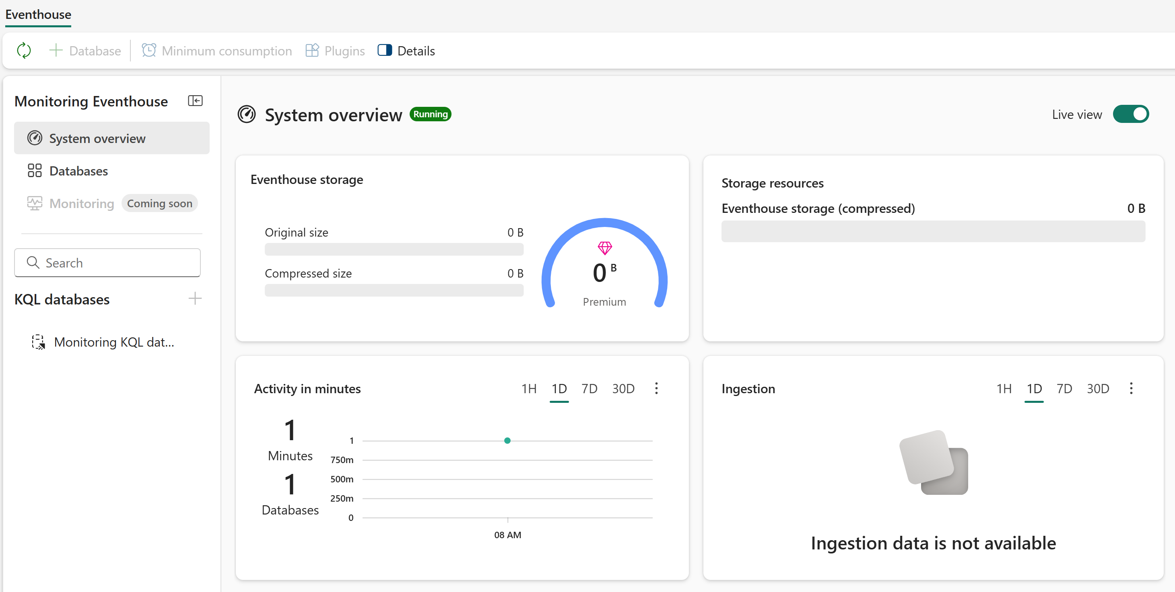
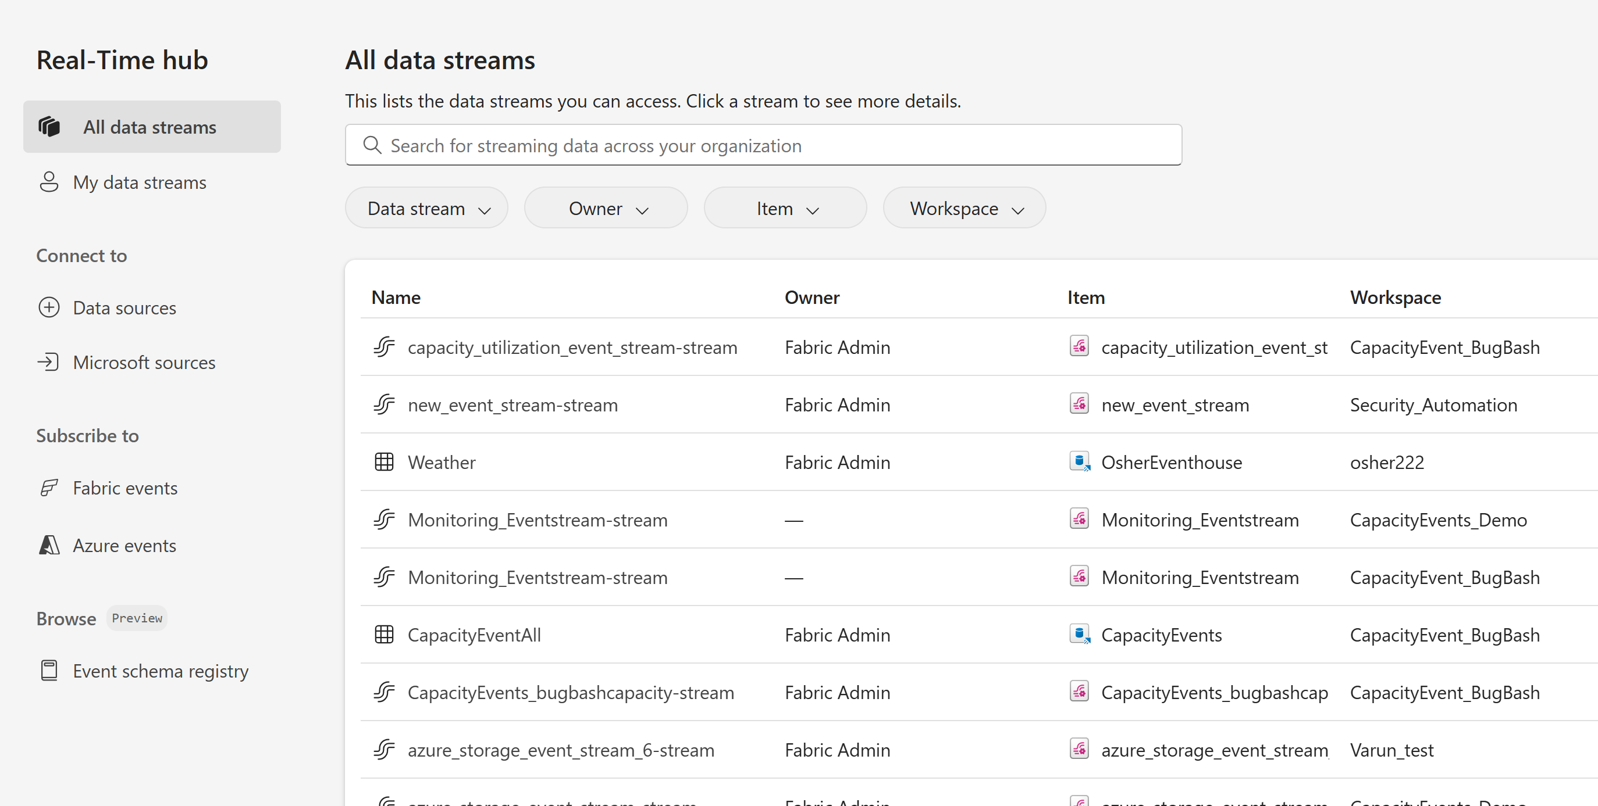
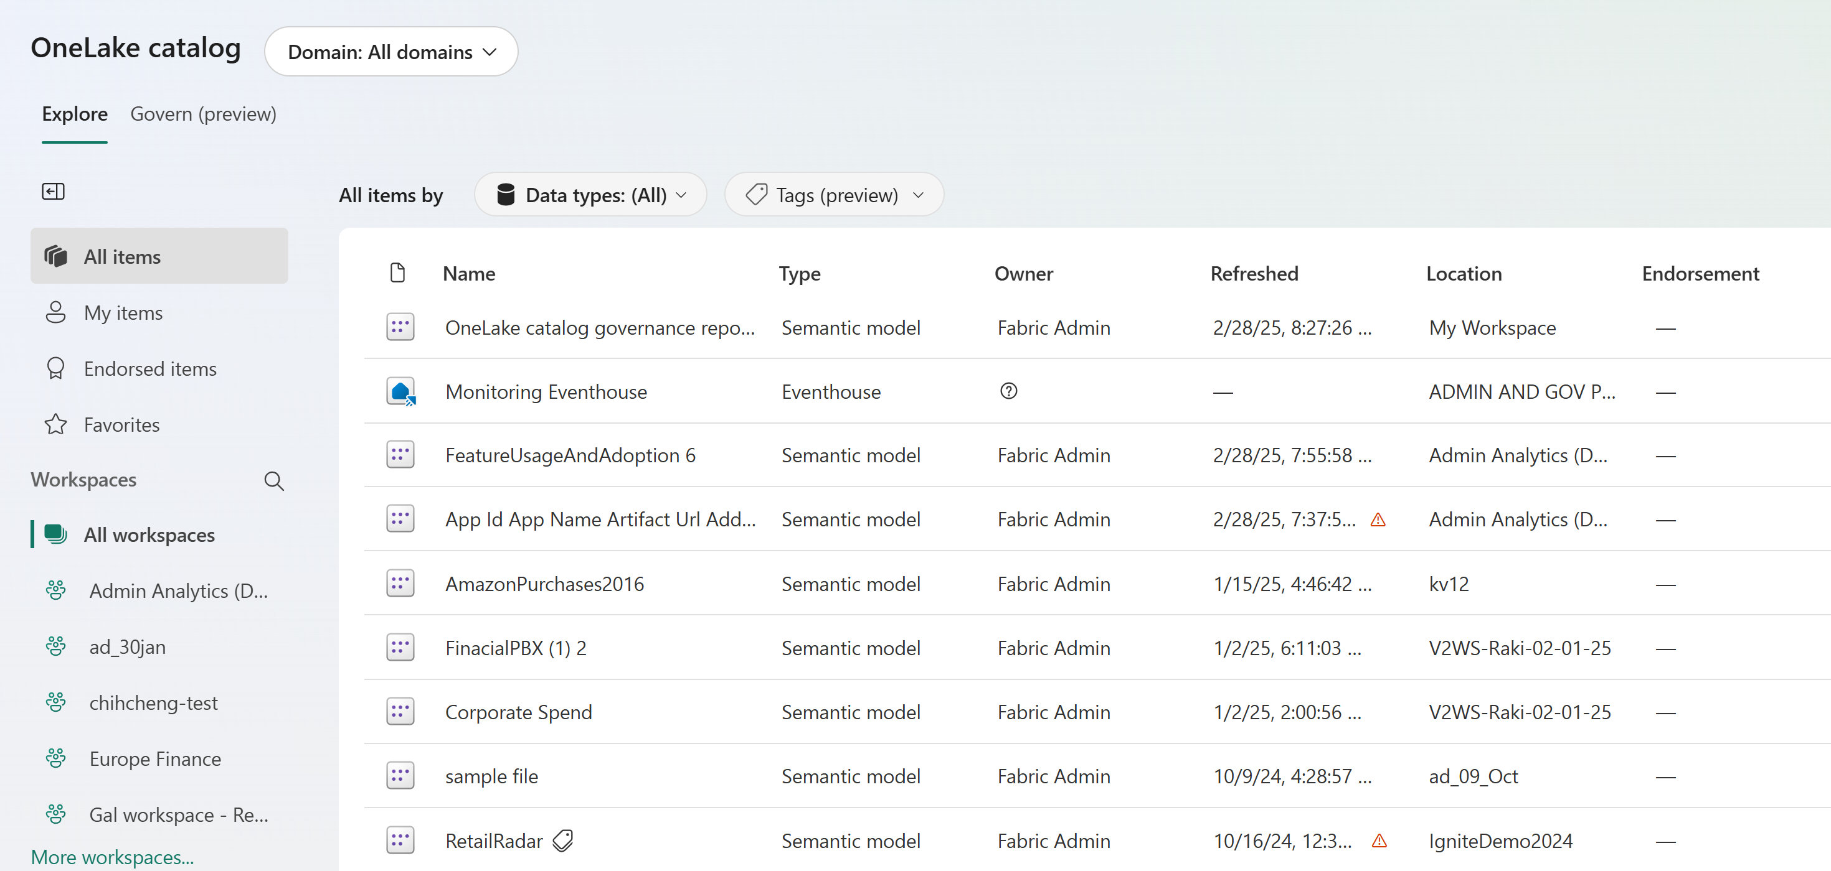
What solution is right for me?
Admin monitoring – Out of the box reports on key governance scenarios | Admin
APIs – Flexible, programmatic data extraction & automation | Admin\Developer
Capacity Metrics App – Capacity management and resource planning | Tenant\Capacity Admin
Workspace Monitoring – Diagnostic logging for Fabric items | Developer
Real Time Hub – Event streaming for Fabric workloads for responsive actions | Developer
OneLake catalog – Actionable lens into your data estate | Developer

Slide 8
What preceded the Admin monitoring workspace?
Activity Events API / Scanner API / etc.
3rd party solutions – PBI monitor, GitHub projects
Admin portal Usage Metrics dashboard
Usage Metrics v1/v2

Slide 9
* Execute Activity Events API & Scanner API * Ingest data into report to build monitoring solution
As a Fabric admin, I want to know who is using Analyze in Excel:

Slide 10
What is the Admin monitoring workspace? (public preview)
One-stop shop for enterprise reporting and analytics
Includes out of the box reporting focused on Fabric tenant management scenarios
Also includes semantic models for customization
Available to all tenants regardless of licensing type or total # of users

Slide 11
Who is the workspace intended for?
Global admins and Fabric administrators
“Power users” such as multi-workspace admins, COE leads
Capacity admins and domain admins

Slide 12
How does it all work?
Data queried from multiple sources, transformed, and landed in a single repository specific to each tenant
Managed, automated data refresh of all semantic models
Out of the box reporting and curated semantic models made readily available via the workspace

Slide 13
Admin monitoring FAQ’s
FAQs:
Hosted on Pro but can be moved to capacity
30 days of “fact” AKA transactional data
Metadata reflects from previous day’s snapshot, retained for 30 days post deletion
Reports take ~5 min to refresh with data upon initial install, will appear blank at first
Limitations/Considerations:
Models can be further customized via composite model, but not edited
Re-init required via Delete API to remove workspace, report, or model shares (but not links)

Slide 15
* Workspace overview * Highlight different sharing options, workspace caveats

Slide 16
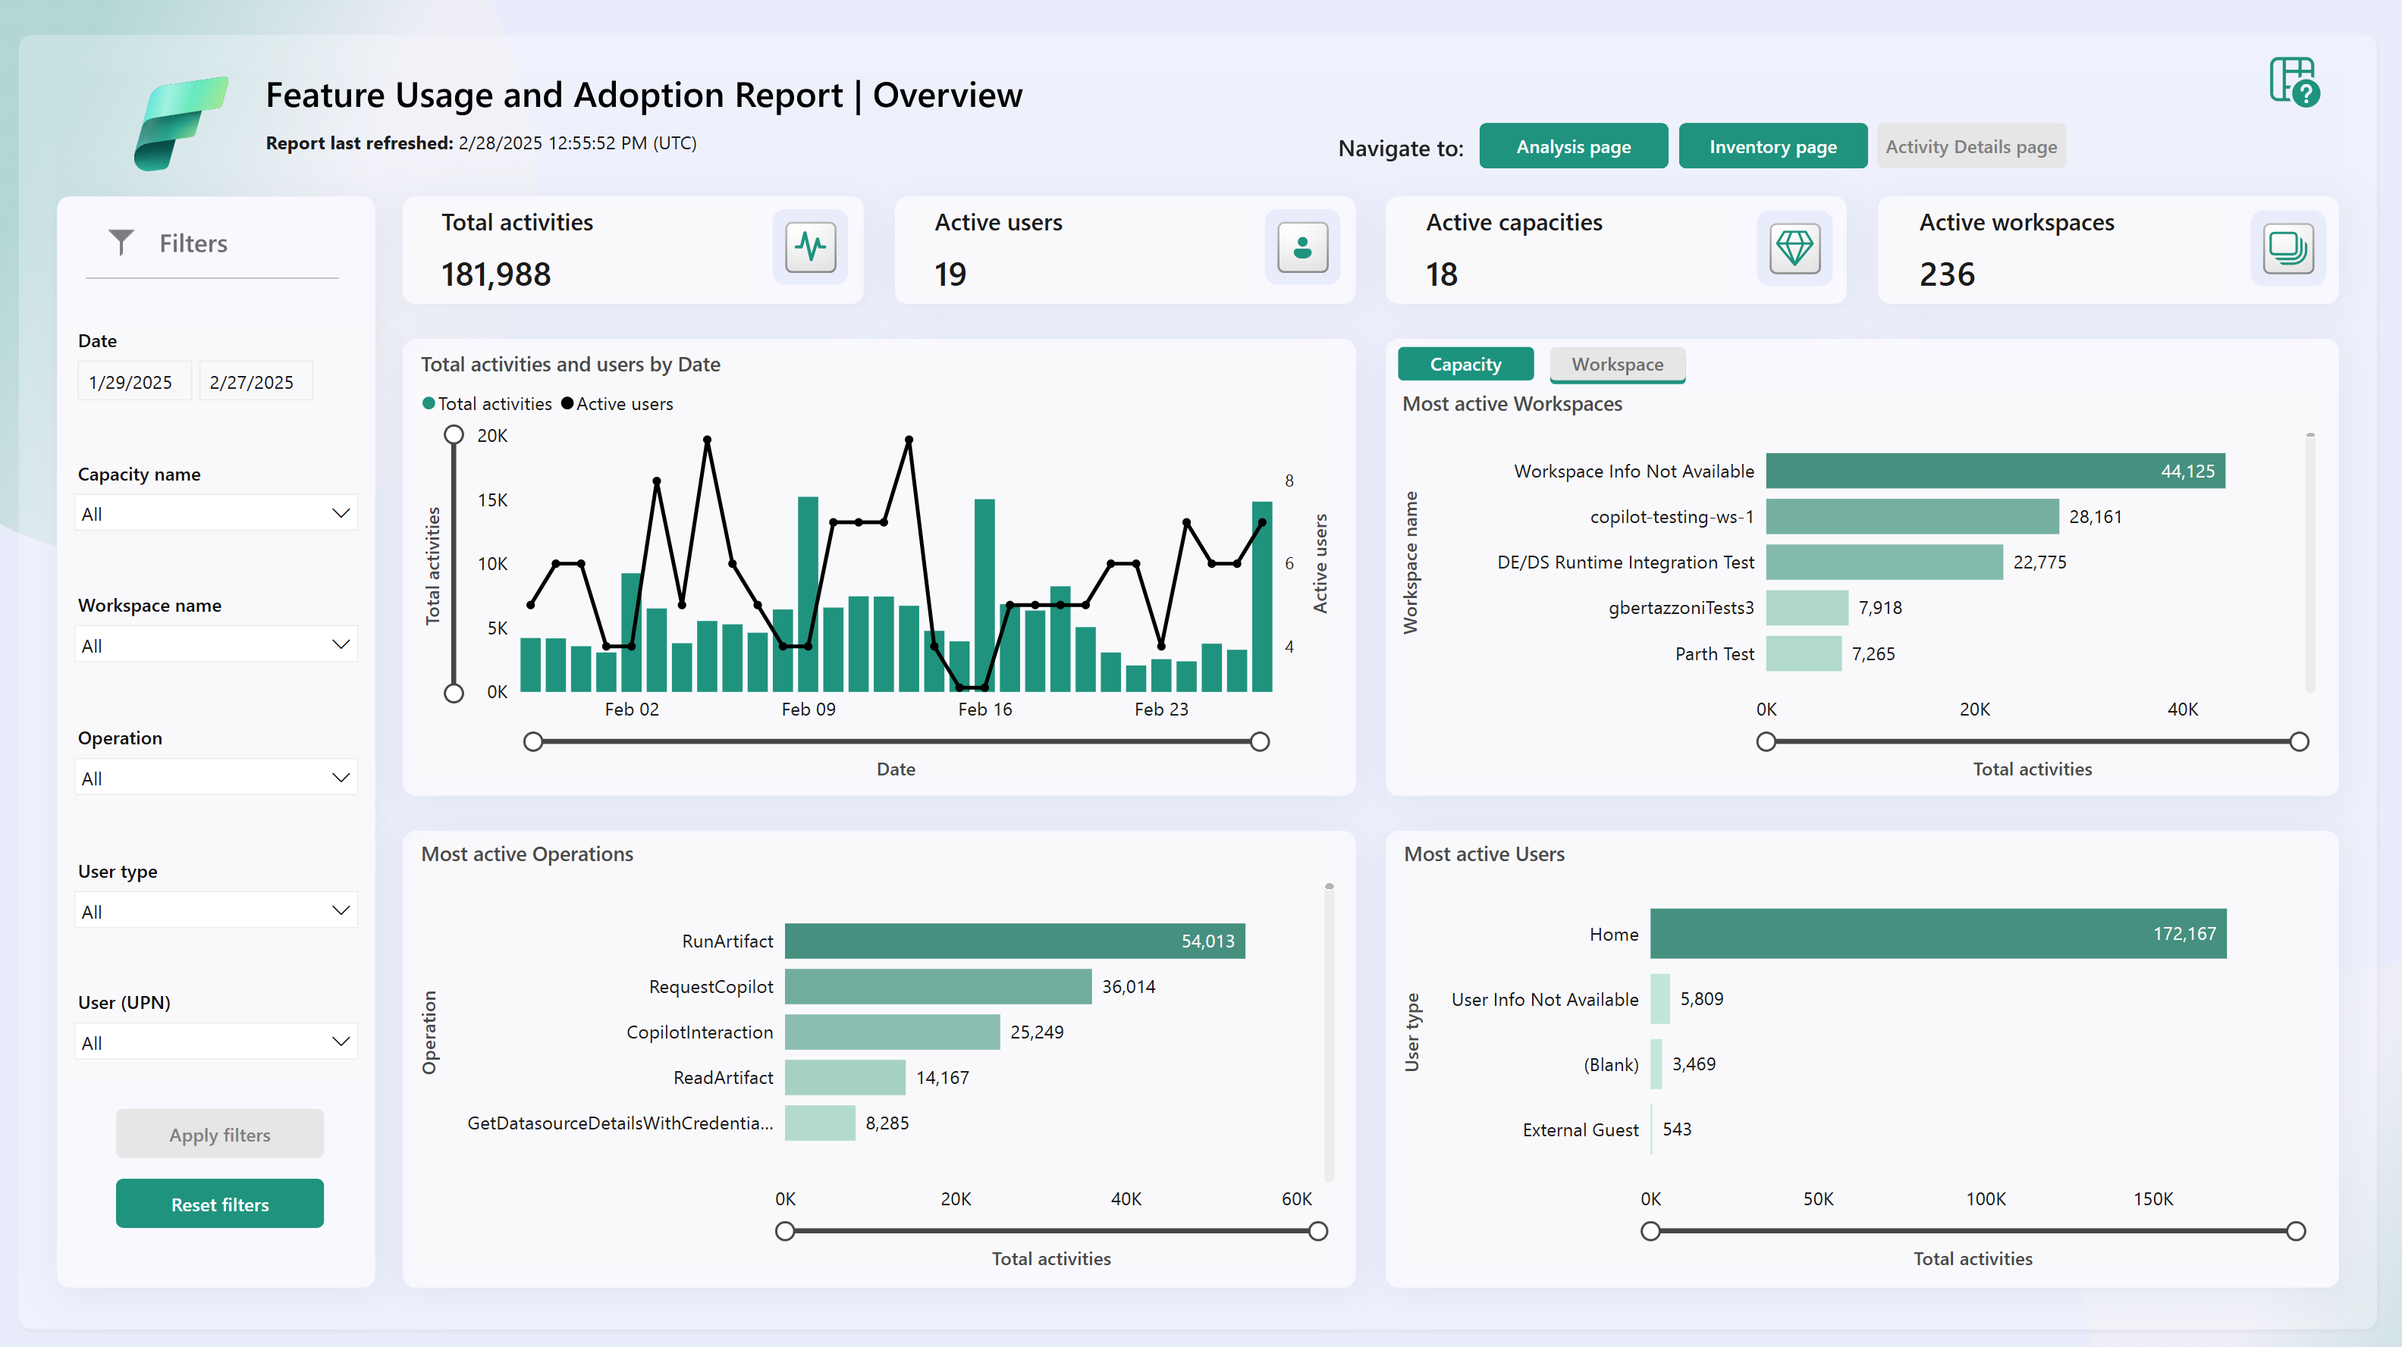
Feature usage and adoption report (public preview)
Audit-focused
What activities are occurring in your tenant, by whom, on which item, and where?
Identify your most ‘active’ or ‘dormant’ items
Investigate activities by home tenant and guest users
Analyze custom scenarios via drill through and flexible visuals

Slide 17
* Report deep-dive: Feature Usage and Adoption report
As a Fabric admin USING ADMIN MONITORING, I want to know who is using Analyze in Excel:

Slide 18
* Connect to AM models in the Service to build custom reports * Use “Explore” feature to create quick analyses

Slide 19
* Connect to models via Desktop / creating a composite model * Adding additional dimensions for custom reporting

Slide 20
Additional links and resources
Public docs:
Admin monitoring workspace
Feature usage and adoption report
Other helpful resources:
Power BI implementation planning
Reach us at: Adminmonitoring@microsoft.com

Slide 21
Questions? And thank you!

Slide 22
