Slide 1
Efficiënter modelleren met DAX User Defined Functions
Marnix Jansen

Slide 2
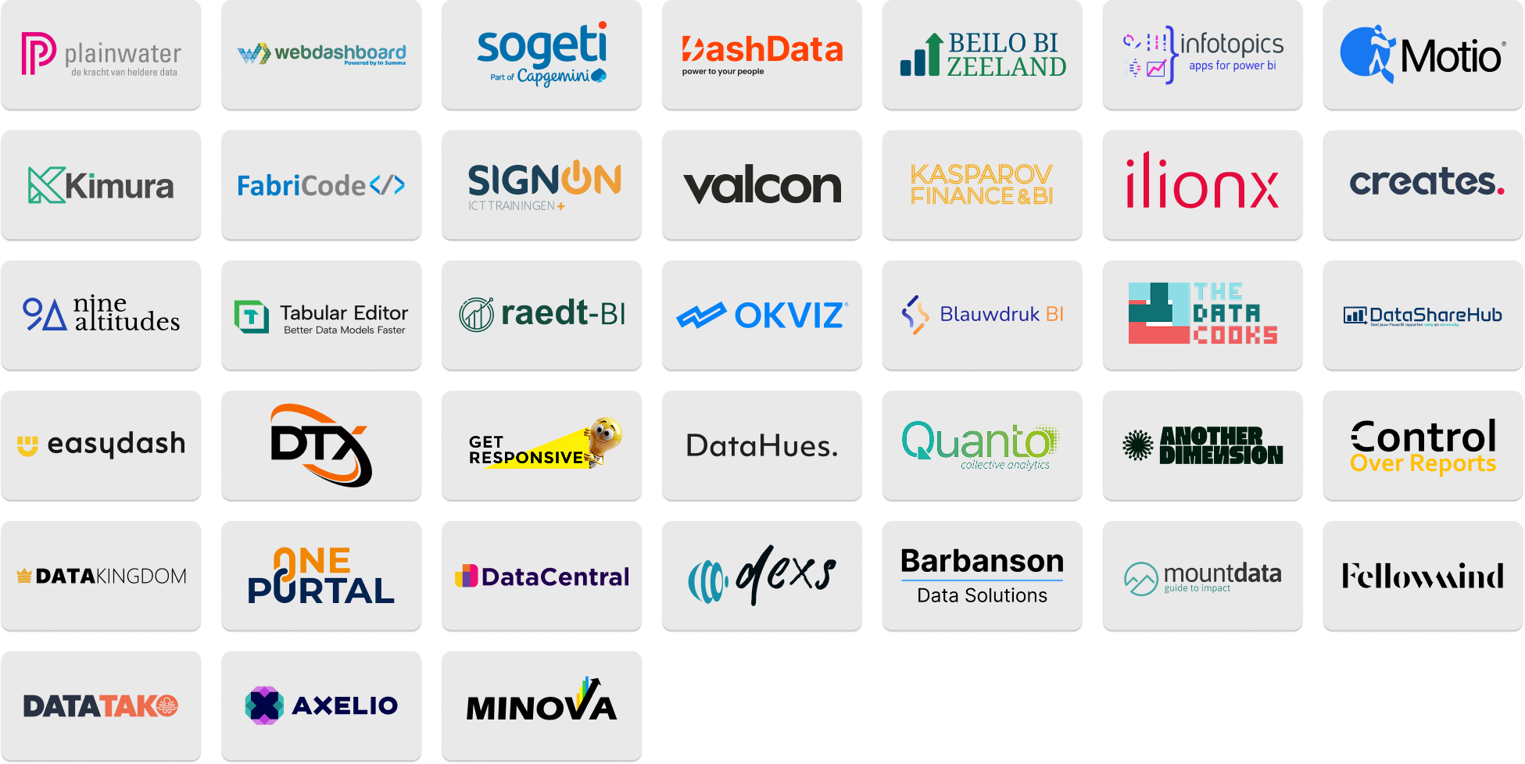


Slide 3
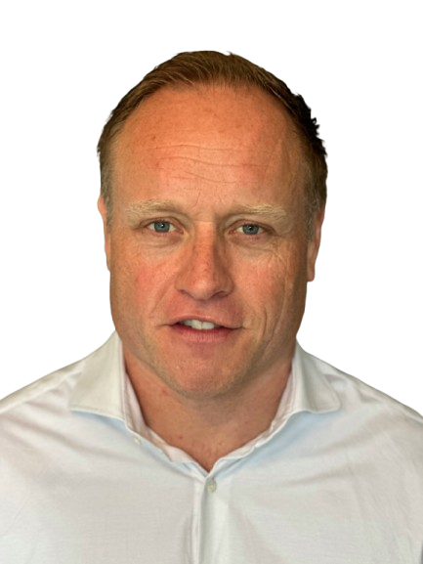





WHO AM I
BI Developer
Microsoft Certified Trainer
Public Speaker
Register Controller
www.minova.nl/blog

Slide 4
Agenda
Why User Defined Functions
Syntax
Filter Context Recap
Examples and Use Cases
UDF vs Calculation groups
DAX Lib

Slide 5
Why User Defined Functions

Slide 6


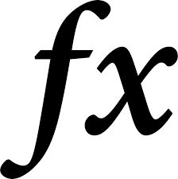



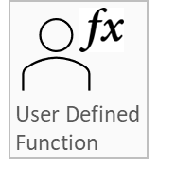
Reusability

Slide 7
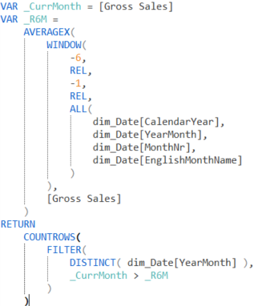
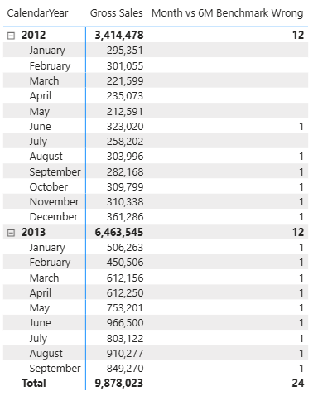
Reading & Writing
Current month VS Previous 6

Slide 8
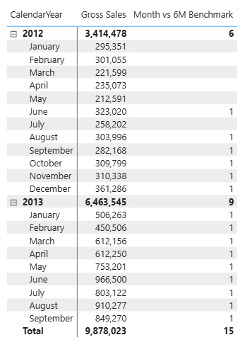
Reading & Writing

Slide 9
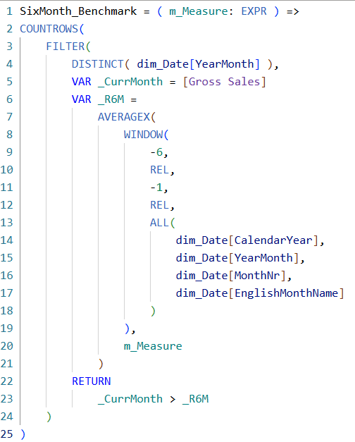
Reading & Writing
Create this function only once…

Slide 10


Reading & Writing
Syntax Sugar

Slide 11
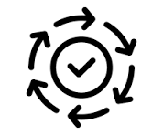
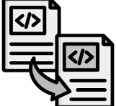
OVOT: One Version Of the Truth
Correctness
Consistency
Avoid duplication of work
Update once, update everything

Slide 12
Syntax User Defined Function

Slide 13
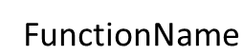
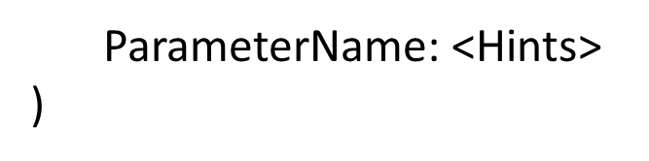


=

Slide 14
Hints require basic understanding of filter context

Slide 15
Filter Context Recap

Slide 16
Filter Context
Filter Context

Slide 17
Filter Context
Populate the Filter Context
Apply the Filter
Propagate the Filter
Do the Math

Slide 18
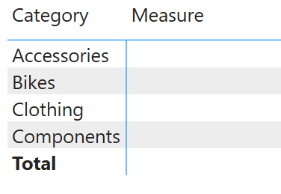
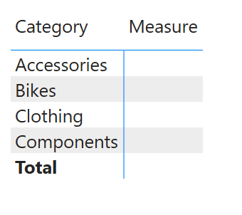
Filter Context
Populate the Filter Context
Filter provided by SUMMARIZECOLUMNS

Slide 19
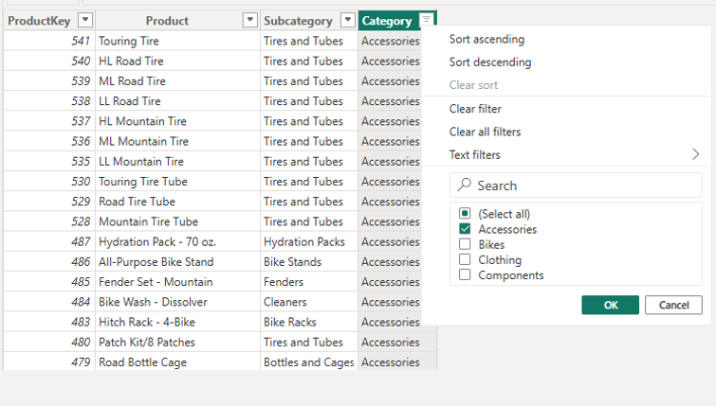
Filter Context
Dim Product
Apply the Filter

Slide 20
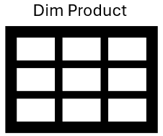
Filter Context
Propagate the Filter
Fact Sales

Slide 21
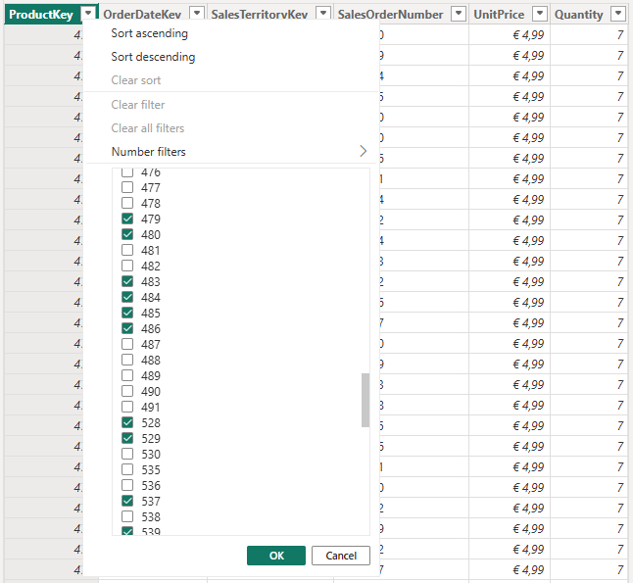
Filter Context
Fact Sales
Propagate the Filter

Slide 22
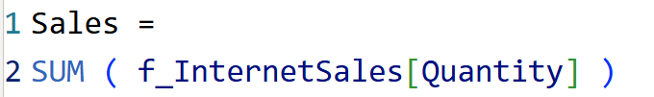
Filter Context
Do the Math

Slide 23


CALCULATE
Apply the Filter
Propagate the Filter
Do the Math

Slide 24
CALCULATE
Initial
Apply the Filter
Propagate the Filter
Do the Math

Slide 25
CALCULATE
Initial
Adjust the Initial Filter Context
Apply the Filter
Propagate the Filter
Do the Math

Slide 26
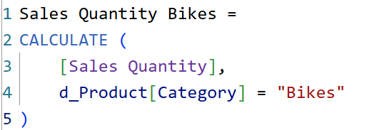

CALCULATE
Adjust the initial Filter Context

Slide 27
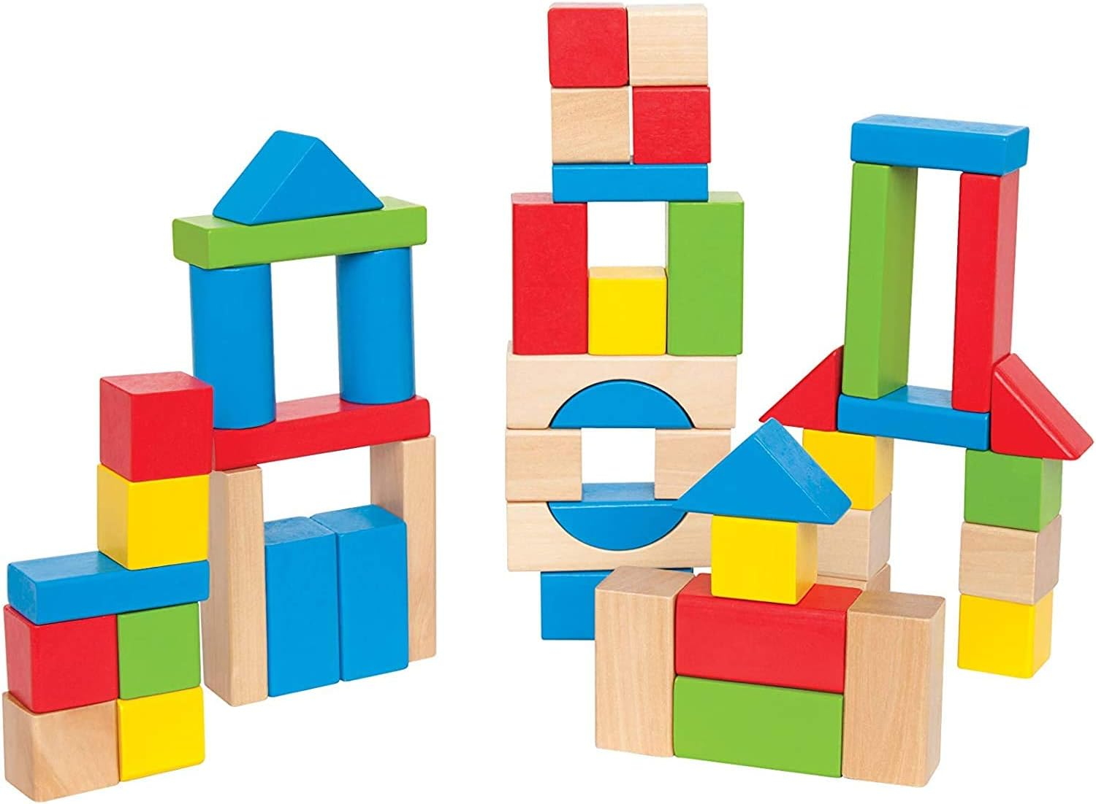
Using Variables

Slide 28

Using Variables
A variable is evaluated within the evaluation context it is defined…
…regardless of the context in which it is called.

Slide 29
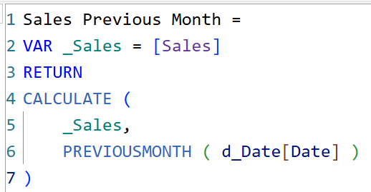
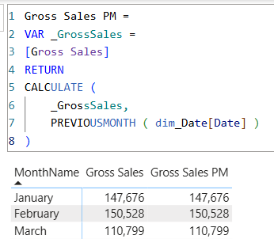
Using Variables
What is the result of this Measure?

Slide 30


Slide 31
Back to those Hints

Slide 32


type
Value types
❓ AnyVal (Default when omitted)
Scalar
Table
Expression types
❓ AnyRef

Slide 33
type
Scalar
Table
Input Control

Slide 34
type
Value types
Eager evaluation
Evaluation context of the caller: populated by everything outside of the UDF
Expression types
Lazy evaluation
UDF modifies caller context

Slide 35


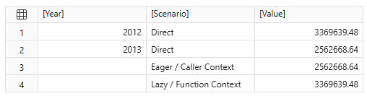
Type
Measure :=
CALCULATE (
<Function> ( [Gross Sales] ),
dim_Date[FiscalYear] = 2013
)

Slide 36
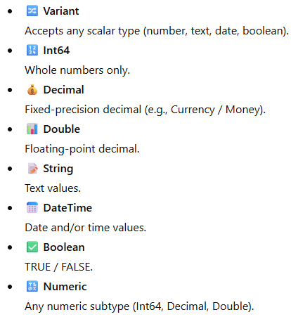
subtype
When specifying a subtype you don’t also need to define the parameter as a scalar.
That is automatically assumed.

Slide 37
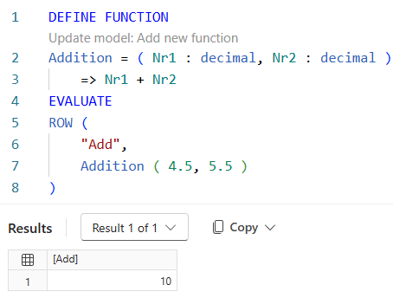
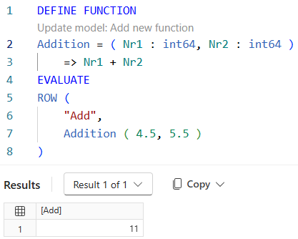
Subtype (datatype)

Slide 38
Hints Recap
🏷️ Type: what do you pass?
1️⃣ Subtype: what is the datatype?
⌚ Passing Mode: when is it evaluated?

Slide 39
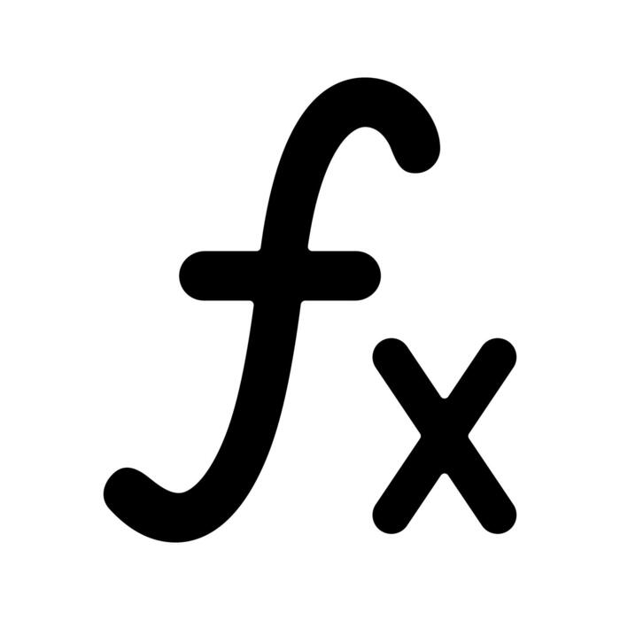
Passing mode
1️⃣
[val] Value
Eager evaluation (evaluation at call site)
[expr] Expression
Lazy evaluation (evaluation inside the function)
Didn’ t we already cover this? 🤔
🏷️ Type: chosen object sets default passing type. Implicit.
⌚ Passing mode: explicitly sets the passing mode and can overwrite the default

Slide 40
Examples and Use Cases

Slide 41

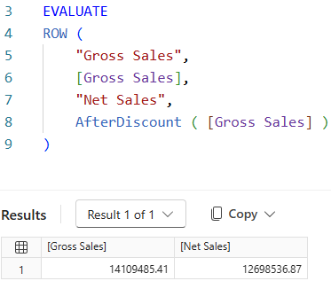
Discount Correction

Slide 42
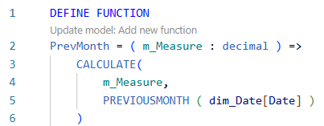
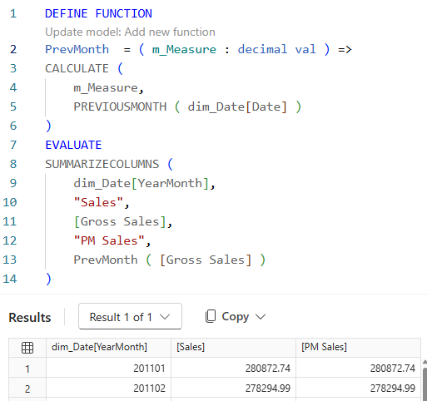
Previous Month
Type decimal, so scalar, so value type, so eager evaluation.
In the context of the caller, not the function
The implicit mode is val (eager), setting it explicitly to val does not change anything

Slide 43
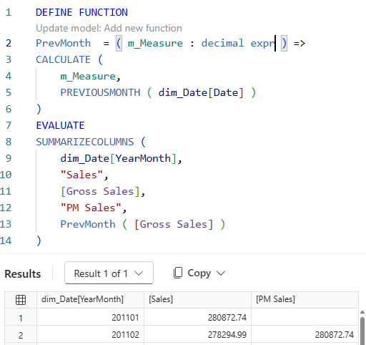
Previous Month
Engine receives an expression which it evaluates in context modified by the UDF

Slide 44
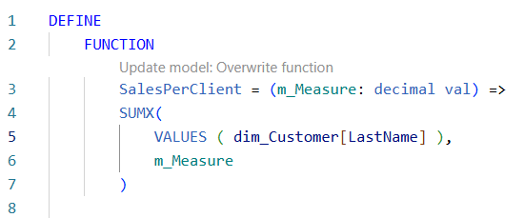
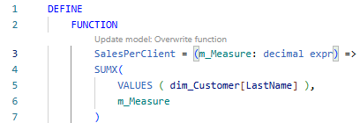
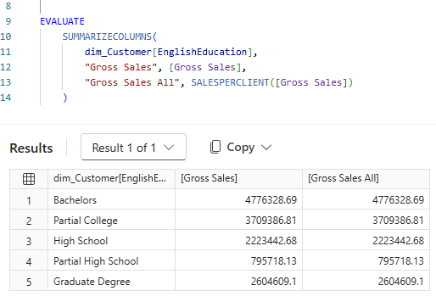
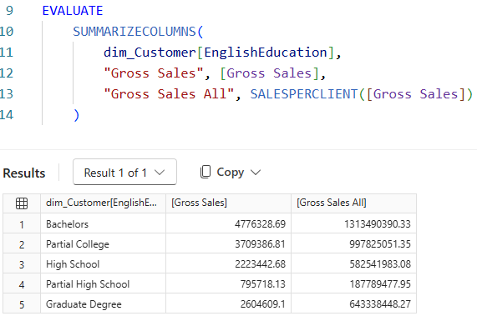
Sales per Client
Engine receives the GrossSales for the total CustomerGroup. That same number is used in the iteration over the customers.

Slide 45
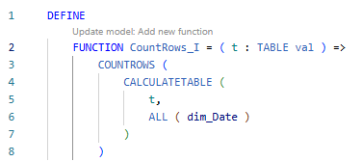
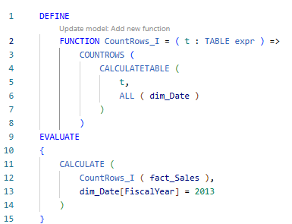
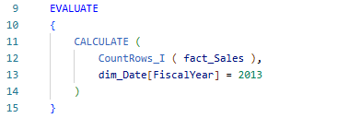


Record Count
Expr: lazy evaluation. The context modification of the UDF is respected.
❓
Val = eager evaluation: evaluated in the context of the caller so the ALL ( dim_Date) is ignored.

Slide 46
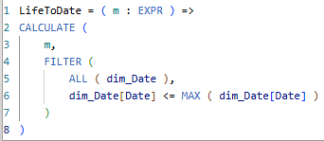
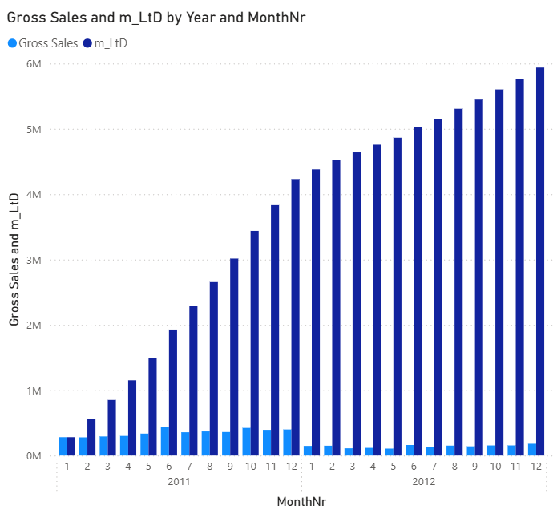

Life to Date

Slide 47
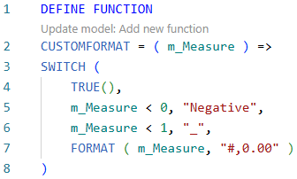
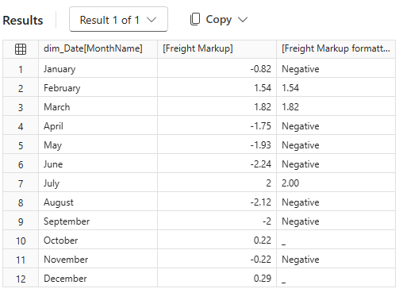
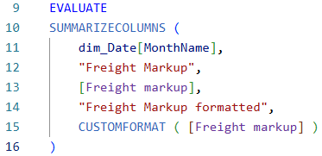
Use Cases
Formatting

Slide 48
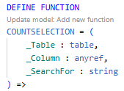
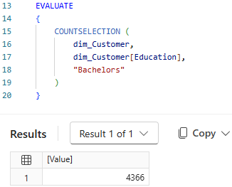
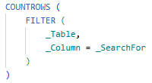

Use Cases
Counting
Intellisense

Slide 49
UDF VS Calculation group

Slide 50
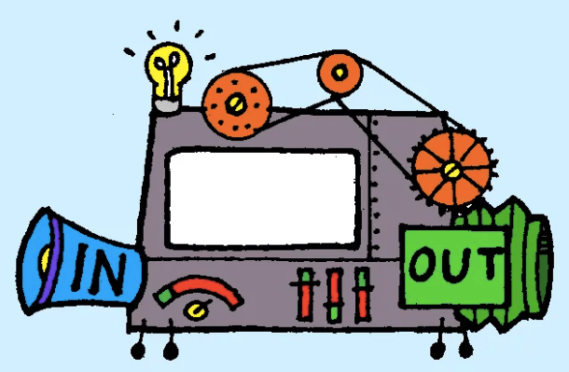

Function
UDF
Calc group

Slide 51
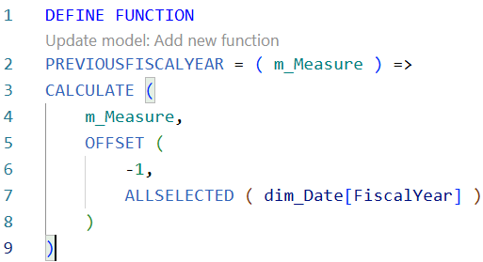
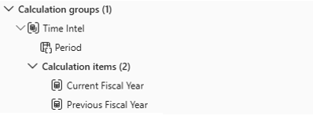

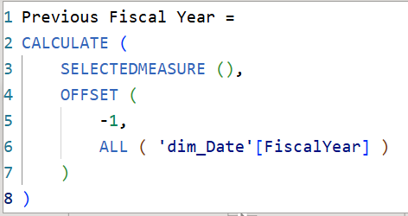
Examples
UDF
Calc group

Slide 52


Examples
UDF
Calc group
Values: Gross Sales
Previous Year: Gross Sales PFY

Slide 53

Dax Lib

Slide 54


Dependency
Dependent
Independent
Local code re-use
Based upon model specific characteristics
Enables portable DAX libraries
Requires generically written UDFs

Slide 55



Example of a Package

Slide 56

Import functions through TMDL

Slide 57

Table without using the function

Slide 58

Function documentation

Slide 59

Table using the function

Slide 60


Loved it? Learned something? Tell us!
Share your feedback in just 1 minute

